Slide 1


MICROSOFT COPILOT FOR WORD

Slide 2
COPILOT IN WORD

Slide 3

Module Agenda
Microsoft CoPilot capabilities in Word
Write Documents from scratch with CoPilot
Write documents from existing PDFs and Powerpoint files on OneDrive
Write documents from existing Emails
Transform unstructured Text into a Table
Chat with Copilot in MS Word
Change the Tone of Voice
Generate Artifacts from a Word Document
© All rights reserved for Dr. Ryan Ahmed @Stemplicity Inc.

Slide 4
Microsoft CoPilot in Word
Microsoft Copilot in Word leverages AI to enhance productivity and streamline document creation.
Content Creation: Generate drafts, summarize text, and rephrase for clarity or tone.
Editing: Fix grammar, spelling, and punctuation while suggesting style improvements.
Formatting: Apply consistent styles, templates, and formatting across documents.
Automation: Handle repetitive tasks like creating tables of contents or applying formats.
Customization: Adjust tone and style to suit branding or audience needs.
© All rights reserved for Dr. Ryan Ahmed @Stemplicity Inc.
Useful Link: https://support.microsoft.com/en-us/office/welcome-to-copilot-in-word-2135e85f-a467-463b-b2f0-c51a46d625d1

Slide 5
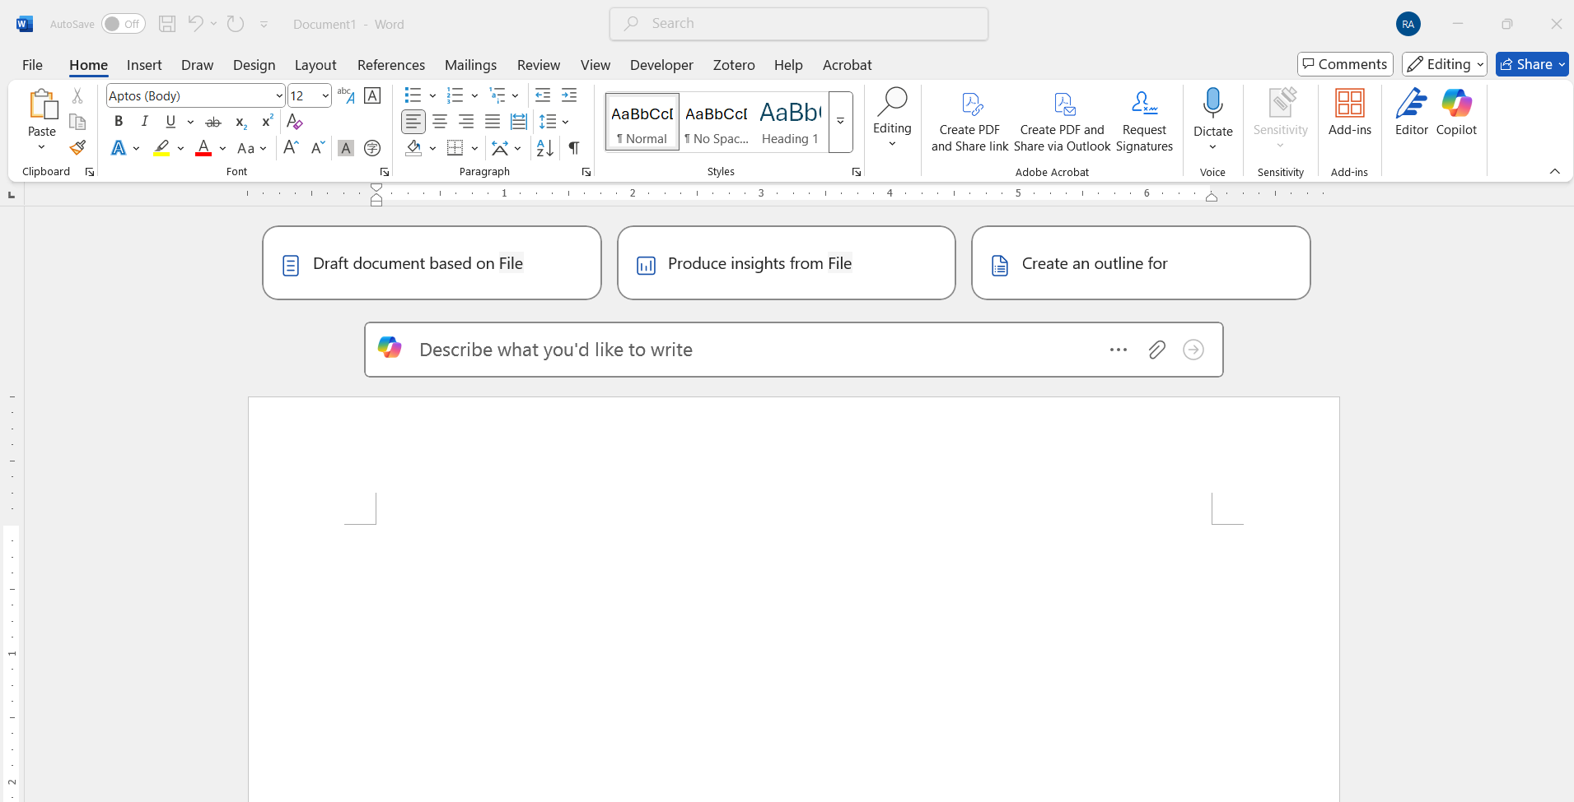
Microsoft CoPilot in Word
© All rights reserved for Dr. Ryan Ahmed @Stemplicity Inc.

Slide 6
LIVE DEMO

Slide 7
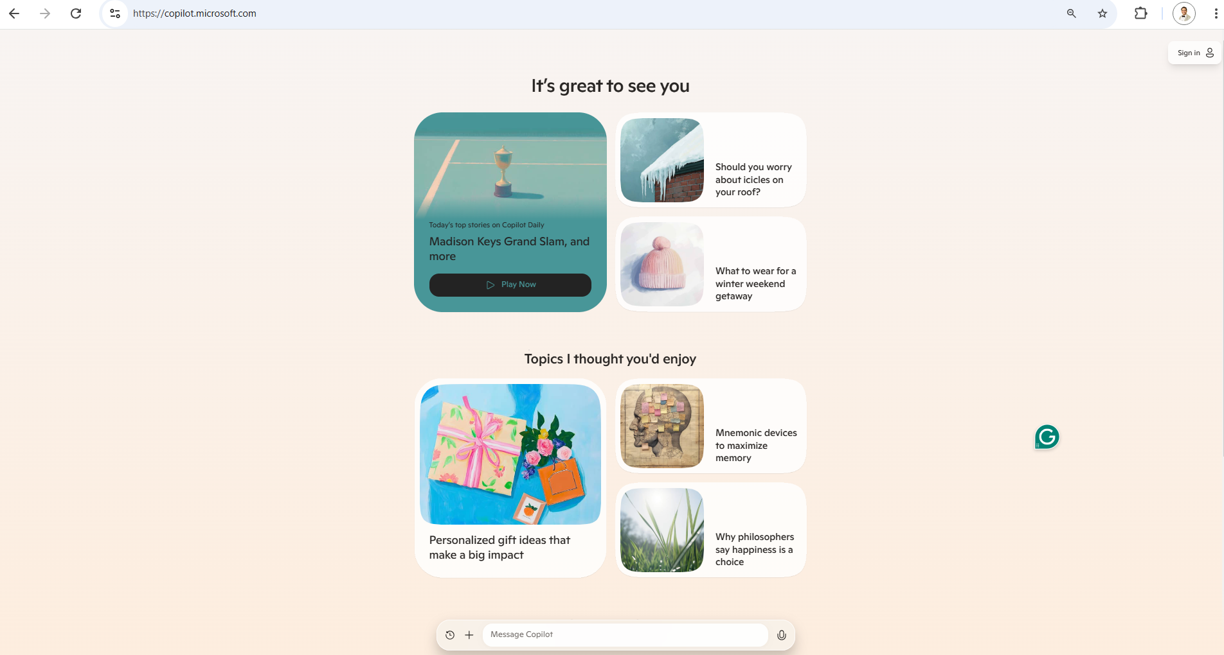
Live Demo
🔗 Click here to explore CoPilot CoPilot Signup
💡 Click here for AI Prompts Explore Prompts
© All rights reserved for Dr. Ryan Ahmed @Stemplicity Inc.

Slide 8
Thank you!

